Slide 1
SS ZG 526: Distributed Computing
Second Semester 2014-2015
Lect 11: Remaining part of DME
Chittaranjan Hota, PhD
Dept. of Computer Sc. & Information Systems
hota@hyderabad.bits-pilani.ac.in

Slide 2
Maekawa’s DME
A site requests permission only from a subset of sites.
Request set of sites S_{i} & S_{j}: Ri, Rj such that Ri and Rj will have at-least one common site (Sk). Sk mediates conflicts between Ri and Rj.
A site can send only one REPLY message at a time, i.e., a site can send a REPLY message only after receiving a
RELEASE message for the previous REPLY message.
SS ZG526, Distributed Computing

Slide 3


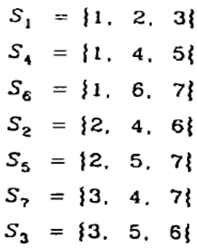
Request Set
SS ZG526, Distributed Computing

Slide 4
Maekawa’s Request set with N=13
R₁ = { 1, 2, 3, 4 }
R₂ = { 2, 5, 8, 11 }
R₃ = { 3, 6, 8, 13 }
R₄ = { 4, 6, 10, 11 }
R₅ = { 1, 5, 6, 7 }
R₆ = { 2, 6, 9, 12 }
R₇ = { 2, 7, 10, 13 }
R₈ = { 1, 8, 9, 10 }
R₉ = { 3, 7, 9, 11 }
R₁₀ = { 3, 5, 10, 12 }
R₁₁ = { 1, 11, 12, 13 }
R₁₂ = { 4, 7, 8, 12 }
R₁₃ = { 4, 5, 9, 13 }
SS ZG526, Distributed Computing

Slide 5
Maekawa’s DME Algo
Requesting the critical section
1. A site Si requests access to the CS by sending REQUEST(i) messages to all the sites in its request set Ri.
2. When a site Sj receives the REQUEST(i) message, it sends a
  REPLY(j) message to Si provided it hasn’t sent a REPLY message to a site from the time it received the last RELEASE message.
  Otherwise, it queues up the REQUEST for later consideration.
Executing the critical section
1. Site Si accesses the CS only after receiving REPLY messages from all the sites in Ri .
SS ZG526, Distributed Computing

Slide 6
Continued…
Releasing the critical section
1. After the execution of the CS is over, site Si sends RELEASE(i) message to all the sites in Ri .
2. When a site Sj receives a RELEASE(i) message from site Si , it sends a REPLY message to the next site waiting in the queue and deletes that entry from the queue. If the queue is empty, then the site updates its state to reflect that the site has not sent out any REPLY message.
SS ZG526, Distributed Computing

Slide 7
Deadlocks
SS ZG526, Distributed Computing

Slide 8
Deadlock handling
FAILED
A FAILED message from site Si to site Sj indicates that Si cannot grant Sj’s request because it has currently granted permission to a site with a higher priority request. So that Sj will not think that it is just waiting for the message to arrive.
INQUIRE
An INQUIRE message from Si to Sj indicates that Si would like to find out from Sj if it has succeeded in locking all the sites in its request set.
YIELD
A YIELD message from site Si to Sj indicates that Si is returning the permission to Sj (to yield to a higher priority request at Sj ).
SS ZG526, Distributed Computing

Slide 9
Token based DME algorithms
A site enters CS if it possesses the token (only one token for the System).
The major difference is the way the token is searched
Use sequence numbers instead of timestamps
  Used to distinguish requests from same site
  Keep advancing independently at each site
The proof of mutual exclusion is trivial
SS ZG526, Distributed Computing

Slide 10
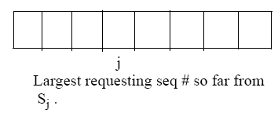
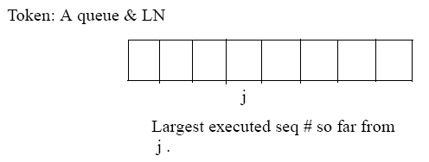
Suzuki-kasami broadcast DME
A site has RN:
LN[j] is the sequence no. of the request that site S_{j} executed most recently.
SS ZG526, Distributed Computing

Slide 11
The DME algorithm
Requesting the critical section.
1. If the requesting site S_{i} does not have the token, then it increments its sequence number, RN_{i} [i], and sends a REQUEST(i, sn) message to all other sites. (sn is the updated value of RN_{i} [i].)
2. When a site S_{j} receives this message, it sets RN_{j} [i] to max(RN_{j} [i], sn). If S_{j} has the idle token, it sends the token to S_{i} if RN_{j} [i] = LN[i] + 1.
Executing the critical section.
3. Site S_{i} executes the CS when it has received the token.
Releasing the critical section.
Having finished the execution of the CS, site S_{i} takes the following actions:
4. It sets LN[i] element of the token array equal to RN_{i} [i].
5. For every site S_{j} whose ID is not in the token queue, it appends its ID to the token queue if RN_{i} [j] = LN[j] + 1.
6. If token queue is nonempty after the above update, then it deletes the top site ID from the queue and sends the token to the site indicated by the ID.
SS ZG526, Distributed Computing

